Slide 1
EP3260: MLoNs Special Topic – Using Machine Learning to solve network security problem
Group 5
Wenqing Yan, Wenjun Xiong, Hao Chen, Yibei Li, Boris Petkovic

Slide 2
Outline
Introduction
Methods
Case Study
Discussion and Future Work

Slide 3
MLoNs Final Presentation
Part I: Introduction

Slide 4
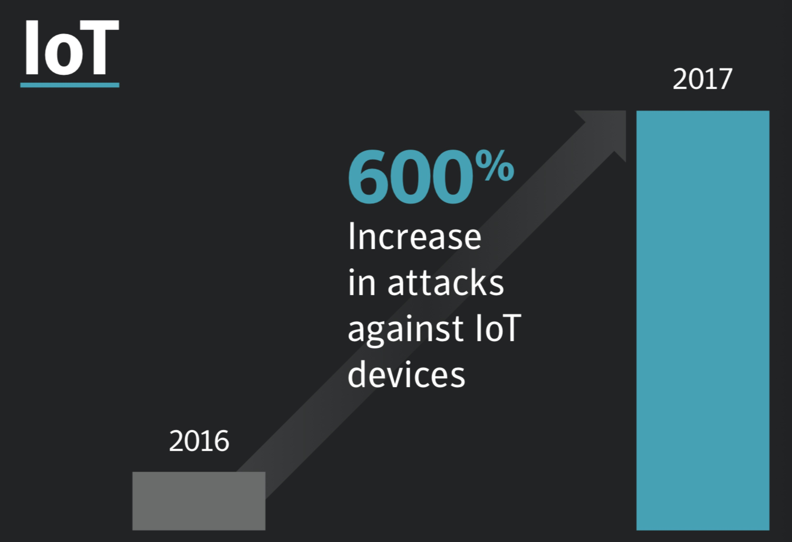
Attacks are increasing
^{Source:} “ISTR Internet Security Threat Report” and PwC ”The Global State of Cybersecurity 2014

Slide 5
Network Security
Goal – Prediction, Prevention, Detection, Response, Monitoring
What to protect
network (network traffic analysis)
endpoint (anti-malware)
application (database firewalls)
user (user behavior analytics)
process (anti-fraud)
Notes:
ML algorithm to use depend on the problem we try to solve

Slide 6
Network Security Solutions
Signatures,
Packet-filtering firewalls
Recognize known threats
Difficult to implement,
Cannot prevent application-layer attacks
Heuristic scanning,
Sandbox protection
Recognize malicious indicators
Rely on known indicators
Machine Learning
Robust
Notes:
Many problems in cyber security are well suited to the application of machine learning as they often involve some form of anomaly detection

Slide 7
Applying ML to Network Security
Regression
detect anomalies in HTTP requests
Classification
a spam filter separating spams from other message
Clustering
forensic analysis to classify all activities to find anomalies
user behavior analytics to detect DDOS attacks and mass exploitation
Has drawn attention in both academia and industrial¹
¹https://www.datavisor.com/products/dcube
Notes:
ML algorithm to use depend on the problem we try to solve

Slide 8
Intrusion and Intrusion Attack
Intrusion: a set of actions aimed to compromise the security of computer and network components in terms of confidentiality, integrity and availability (CIA).
Intrusion attack
Virus
Worm
DoS
…
Intrusion Detection
Signature (misuse) detection
Anomaly detection
Notes:
Misuse detection uses patterns of well-known attacks or weak spots of the system to identify intrusions.
Anomaly detection tries to determine whether deviation from the established normal usage patterns can be flagged as intrusions.
Intrusion detection (mitigate attack): identify unusual access or attacks to secure internal network.
Signature detection: difficult to implement on embedded devices (limited computation and communication resources, hard to frequently update and patch)

Slide 9
Network Anomaly Detection
Objective: Identify unusual patterns that do not conform to expected behavior
Regression to predict the network packet parameters and compare them with the normal ones
Classification to identify different classes of network attacks such as scanning and spoofing
Clustering for forensic analysis
Notes:
Anomaly detection is an important data analysis task which is useful for identifying the network intrusions
finding patterns in network traffic that do not conform to the expected normal behavior

Slide 10
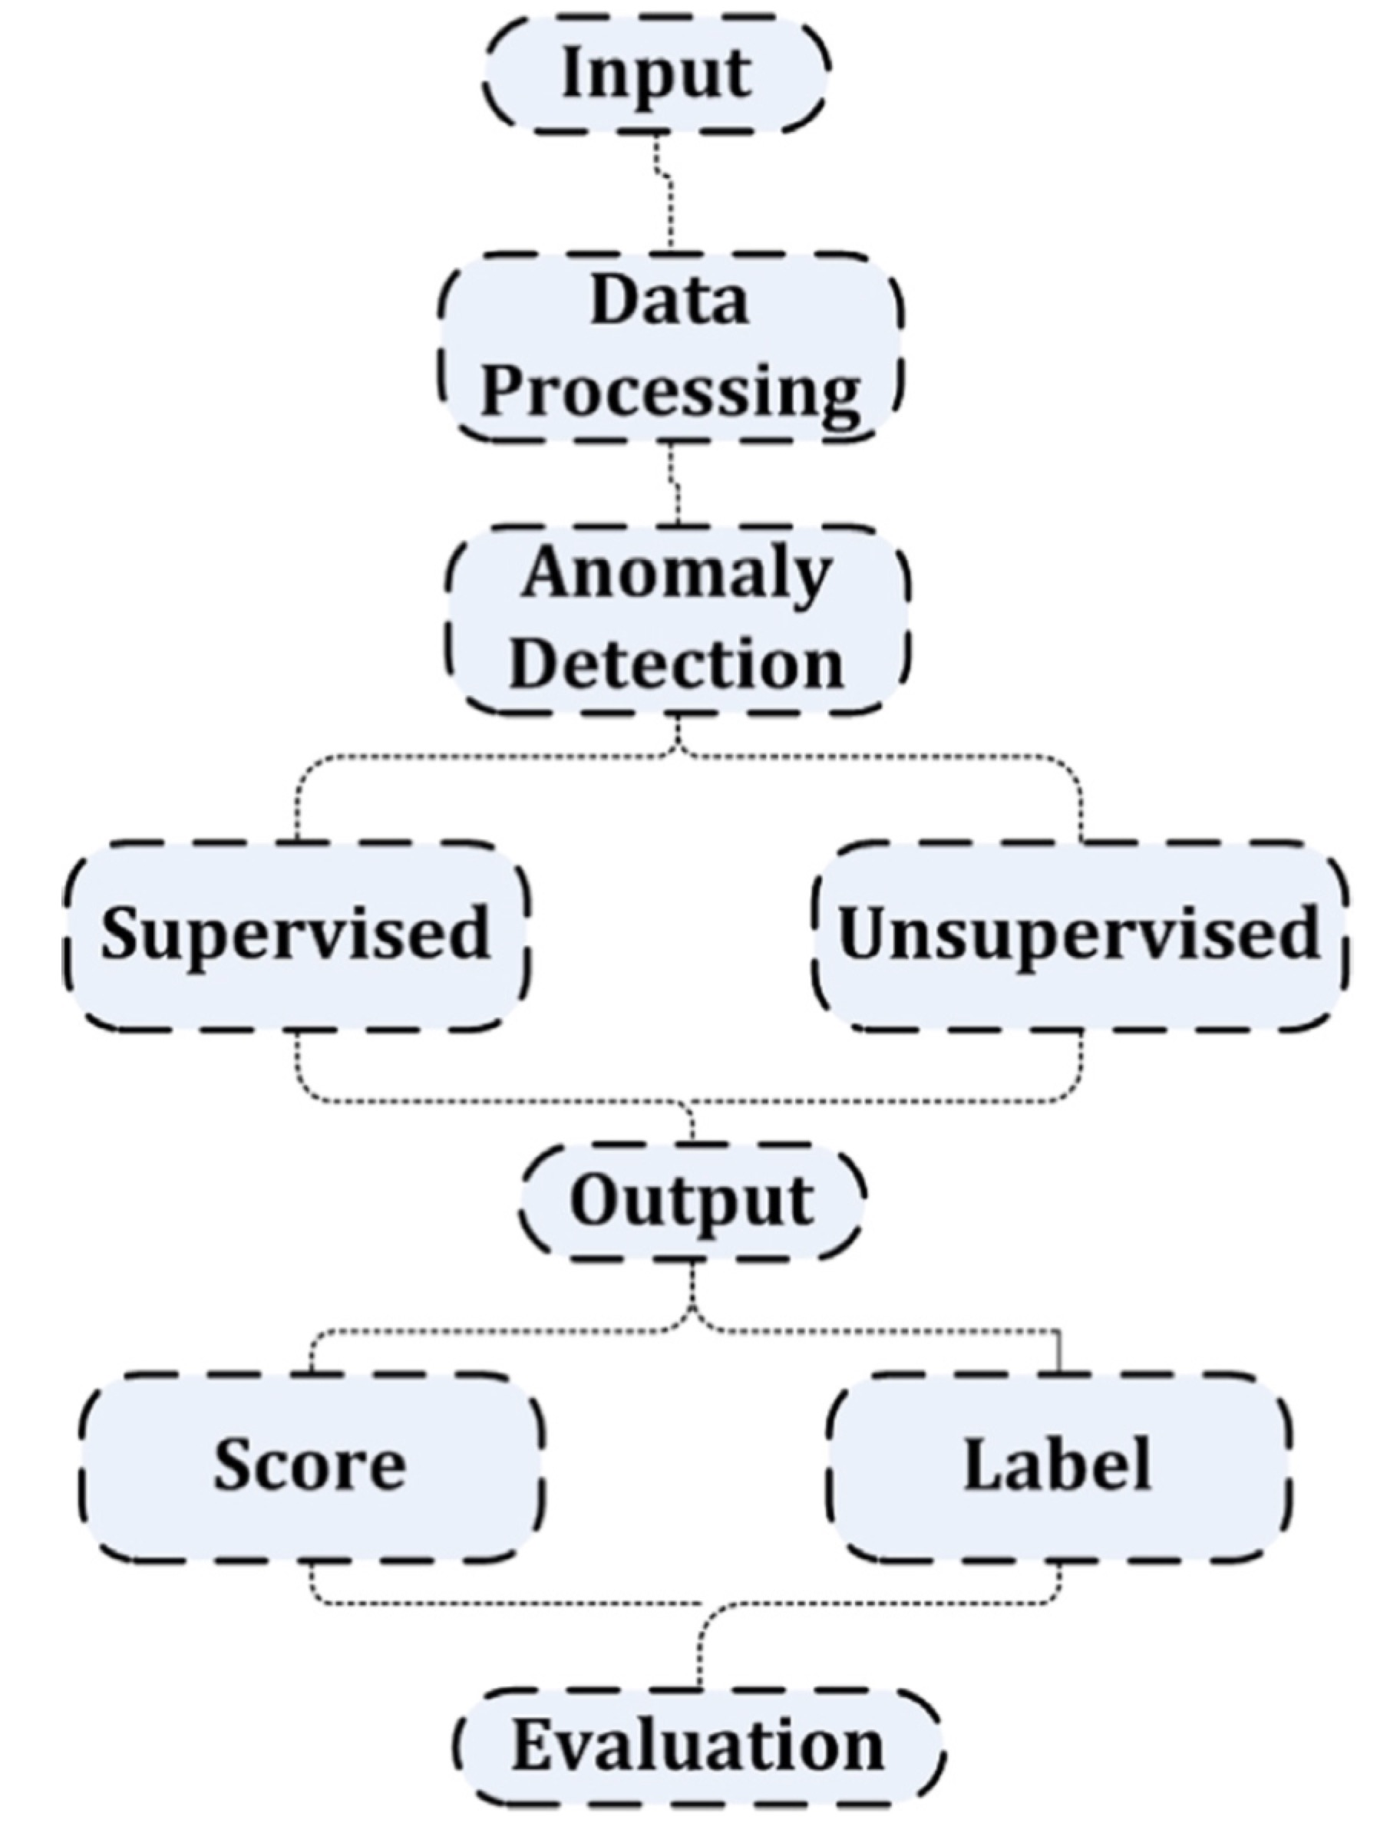
Generic framework for network anomaly detection¹
Different data types
Based on individual detection techniques
Evaluation of output
¹Ahmed, Naser Mahmood, and Hu. "A Survey of Network Anomaly Detection Techniques." Journal of Network and Computer Applications 60.C (2016): 19-31
Notes:
The input data requires processing because the data are of different types
Processing techni- ques are based on the individual anomaly detection techniques

Slide 11
MLoNs Final Presentation
Part II: Network anomaly detection methods

Slide 12
Classification of Operation Modes
Supervised classification
Pre-labeled data: both normality and abnormality
Task: train predictive models for classification
Semi-supervised recognition
Only model normality
Unsupervised clustering
Does not require training data
Build statistic model for data

Slide 13
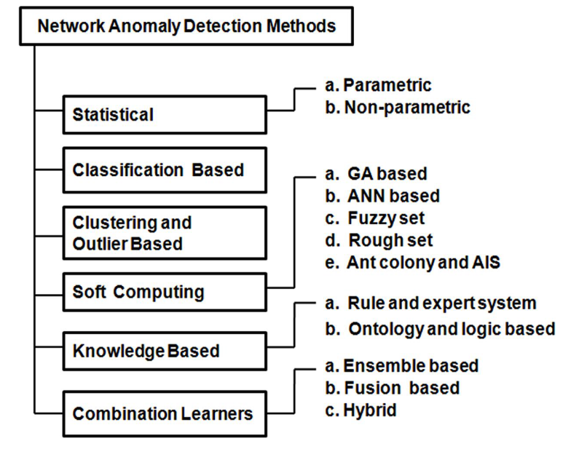
Existing Methods

Slide 14
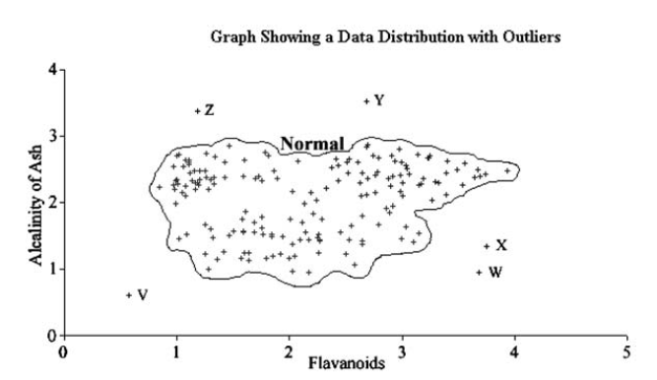
Statistical methods
Method: processes the data as a static distribution
Outliers: the most remote points
Task: estimate statistic distribution (pdf)

Slide 15
Statistical methods
Parametric method
Assumption: observations are drawn from one of a known family of distributions
Task: estimate parameters in a single distribution
Example: normal distribution (estimate mean & covariance)
Drawback: require prior knowledge of models
Non-Parametric method
Does not assume knowledge of the underlying distribution
Example: kernel methods, Bayesian networks
Notes:
Non-parametric: the overall form of the PDF is derived from the data, not merely the free parameters within an otherwise rigid model.

Slide 16
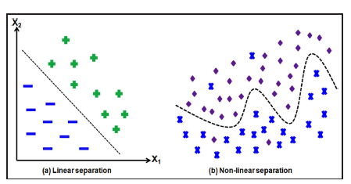
Classification-based methods
Task:
Build explicit or implicit model to categorize data into different classes
Examples of techniques
k-nearest neighbor, support vector machines, decision trees, …

Slide 17
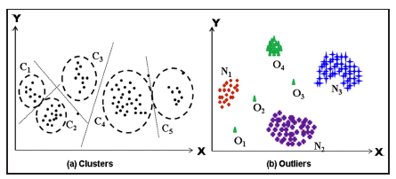
Clustering and Outlier-based methods
Assumption:
larger clusters: normal
smaller clusters: attack or intrusion
Examples of techniques
single-link clustering, k-means (squared error clustering), and hierarchical clustering,…

Slide 18
Knowledge-based methods
Basic Idea:
Network or host events are checked against predefined rules or patterns of attack.
Method:
Search for instances of known attacks, by attempting to match with pre-determined attack representations.
Examples of techniques
Rule-based and Expert system approaches
Ontology and logic-based approaches

Slide 19
Combination of other tools
Different kinds of neural networks
Fuzzy association rule (used for describing different classes)
Rough set theory:
Approximate a regular set with lower and upper approximation
Enabling learning with small size training datasets
Overall simplicity
Computational methods for optimization
Genetic algorithm, Ant colony algorithm, …

Slide 20
Things to consider for own problems
Choice of proximity measures
Feature selection methods
reduces computational complexity
removes information redundancy
Steps: subset generation → subset evaluation → validation
Deal with big datasets
Lower dimensionality data projections
Distributed algorithms
Notes:
Redundancy: eliminating unimportant or irrelevant features

Slide 21
MLoNs Final Presentation
Part III: Case Study

Slide 22
Case Study
Li, F., Shinde, A., Shi, Y., Member, S., Ye, J., & Member, S. (2019). System Statistics Learning-Based IoT Security : Feasibility and Suitability. IEEE Internet of Things Journal, X(X), 1–8. https://doi.org/10.1109/JIOT.2019.2897063
Notes:
Simple statistic learning has the potential to solve this problem

Slide 23
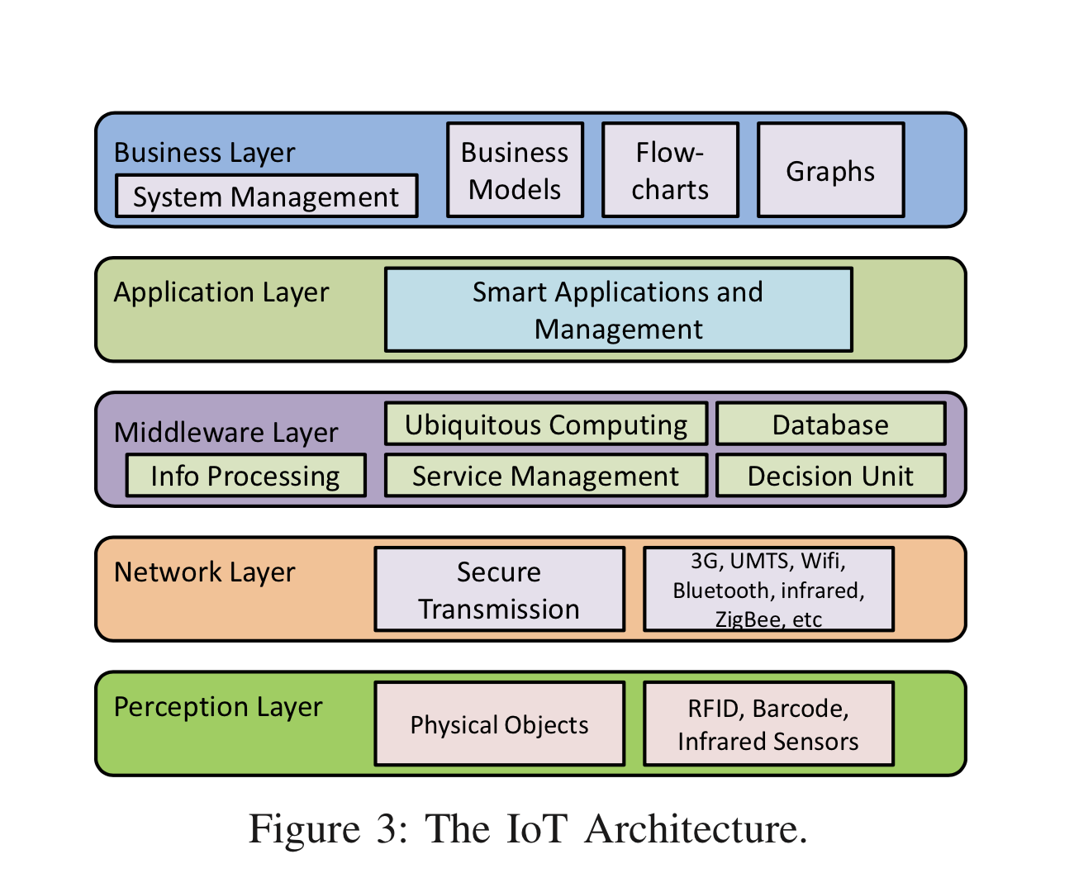
Different Attacks in IoTs
SQL injection, authentication failure
System Usage Data
MITM, DoS
Attacker may steal or tamper with the data that sensors collect

Slide 24
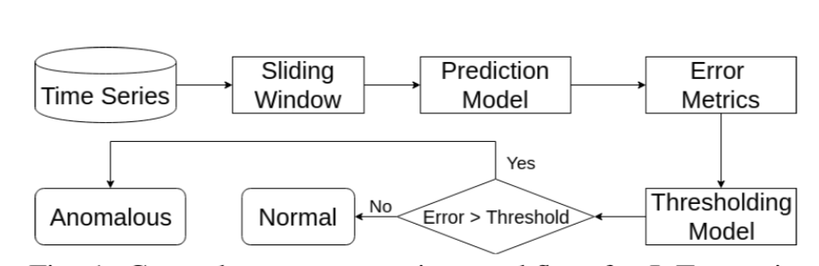
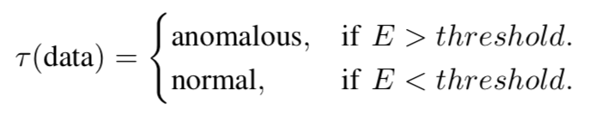
General System Workflow
Notes:
In this six category, the paper belongs to the first one Statistical methods,
Method: processes the data as a static distribution
Outliers: the most remote points, deviate
Task: estimate statistic distribution (pdf)
Existing methods typically monitor each system resource or state for every compute node independently for potential deviations or anomalies relying on a pre-defined threshold. Such methods can identify only those anomalous scenarios in which an individual node exhibits significant deviation for individual resources.

Slide 25
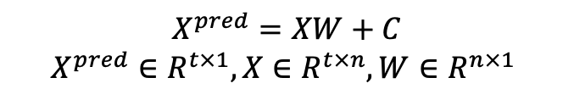
Algorithms – Time Series
Data
…
…
t
# Order: n
$$X^{pred}=XW+C$$
$$X^{pred}∈R^{t×1}, X∈R^{t×n}, W∈R^{n×1}$$
Linear
Neural Network (NN)
Recurrent Neural Network (RNN)
Notes:
They only mentioned “gradient descent” method in paper， no details. Keras
Common situation of engineering research, less care about optimization algorithm

Slide 26
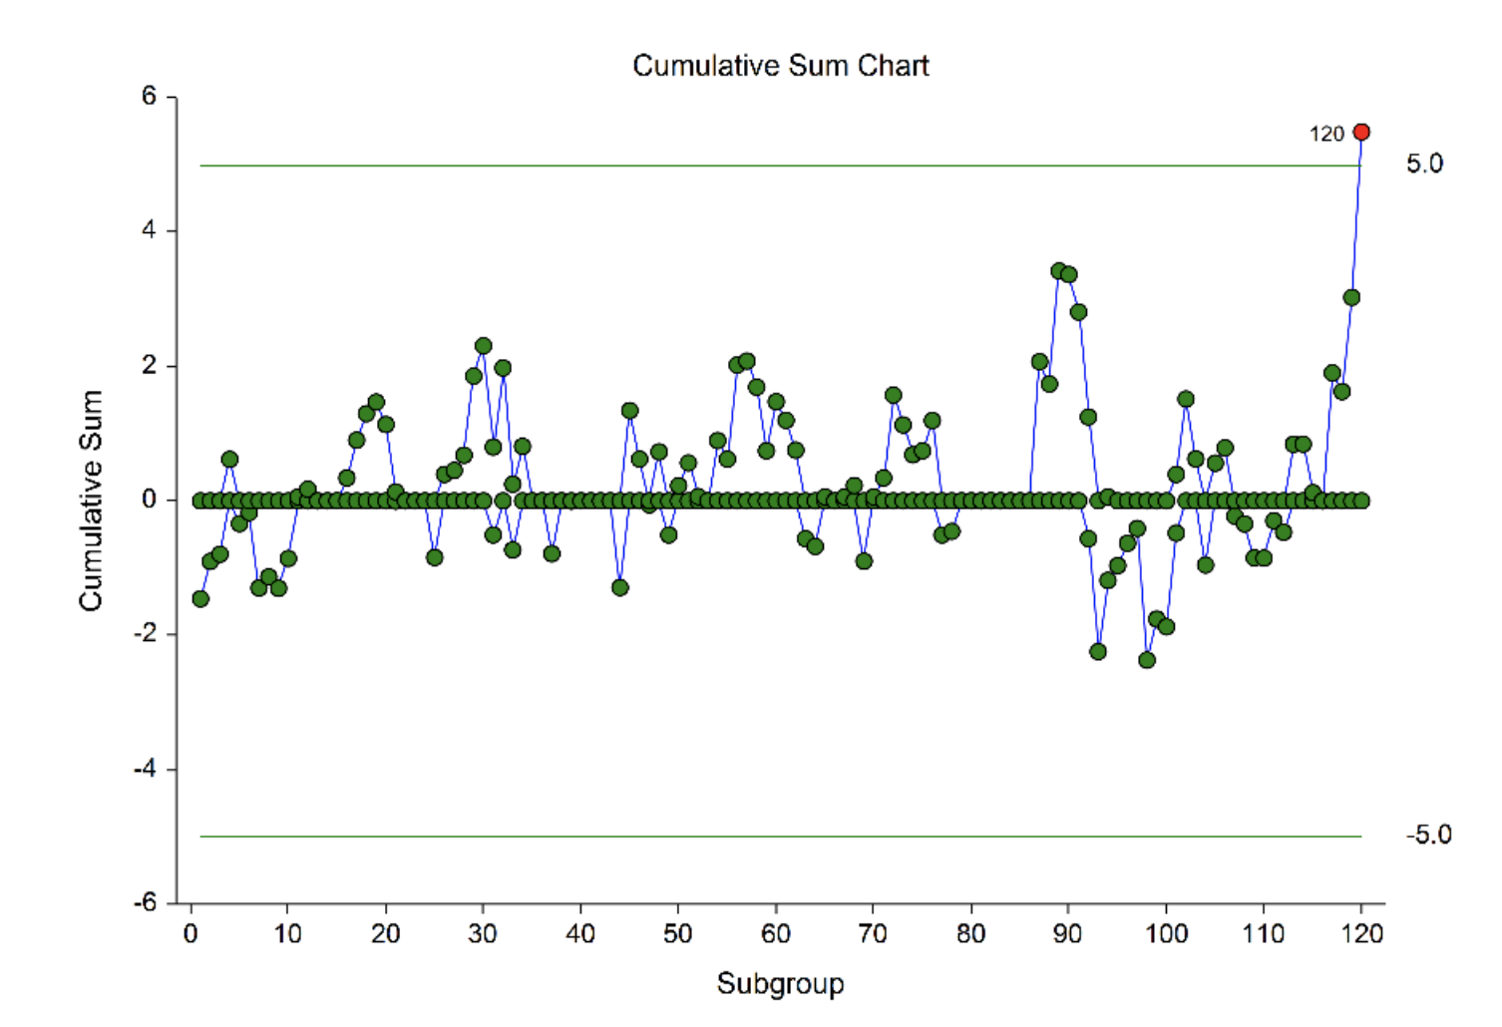
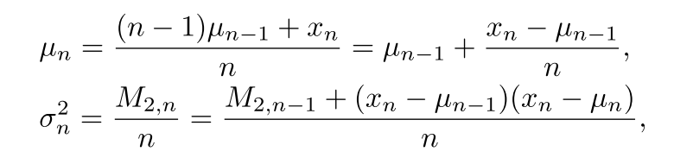
Thresholding Methods
#2. Cumulative Sum Control Chart (CUSUM)
#1. Local Outlier Factor (LOF)
#3.Adaptive Online Thresholding (AOT)
Notes:
LOF: comparing the local density of a point with the densities of its neighbors. A has a much lower density than its neighbors.

Slide 27
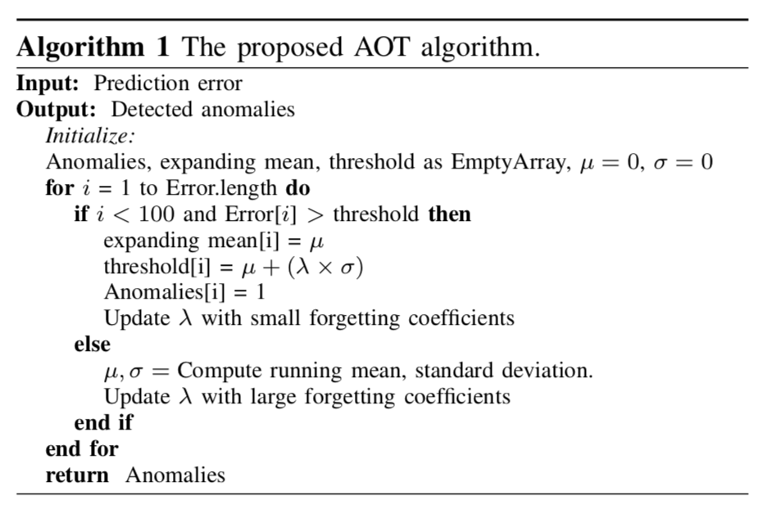
Thresholding Methods
Adaptive Online Thresholding (AOT)

Slide 28
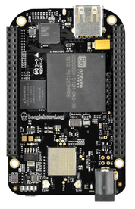
Performance evaluation
System Setup
12 BBB wireless boards, A router, An aggregation server
Carries some operations
Attack Design
Unauthorized access
Port scan
Virus
Flood
Notes:
Operations: signal processing, storage, compression, and transmission operations
Unauthorized access: lack authentication, sensitive data manipulation;
Port scan: send a message to each port to test if the port has some weekness;
Virus: run extra process
Flood: DoS, make the device unreachable.
We use ’collected’, a statistics collection daemon for Linux/Unix systems, to collect various system statistics from 12 BBB nodes

Slide 29
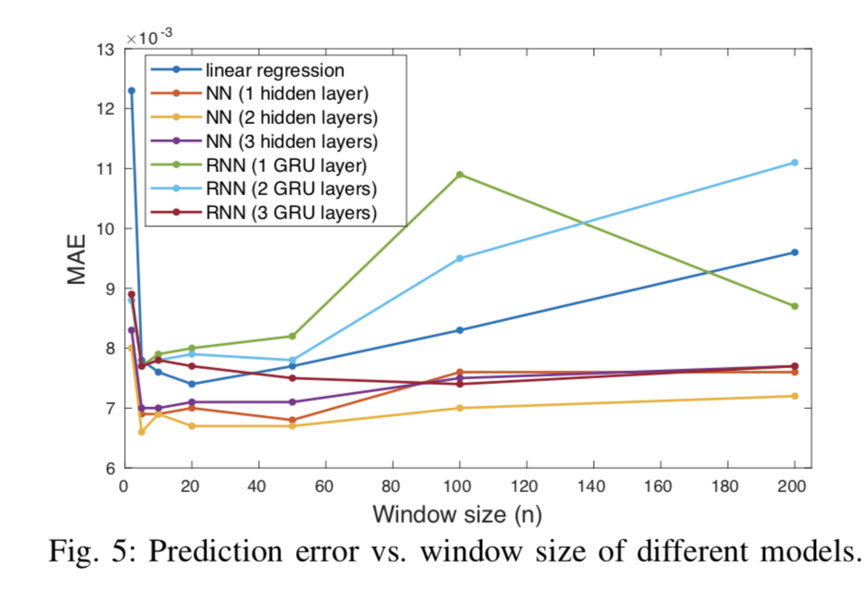
Results and Evaluation : Model Suitability
Notes:
Various windows sizes, respectively.
Best: 20 time samples.
It is clear to see that NNs outperforms

Slide 30
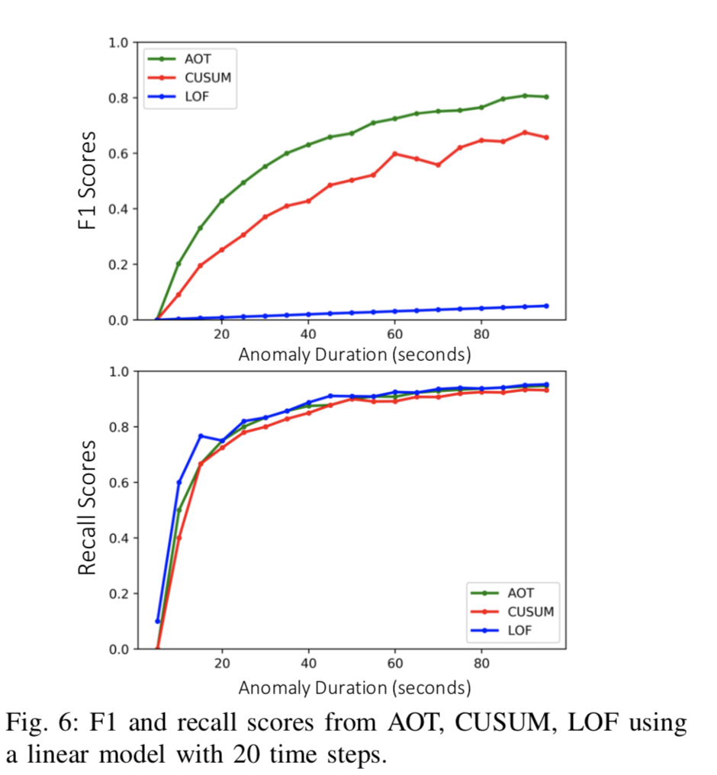
Results and Evaluation : Anomaly Detection Method Comparison
Notes:
Here we use F1 score to quantitatively evaluate how well the methods detect anomalies with different durations.
In general, as the duration of the anomaly increases, the F1 measure of the anomaly should increase as well.
In such condition, the model with rhe better F1 measure for a given time window is better for anomaly detection.
Fig. 6 shows the F1 and recall scores of the model for various anomaly durations.
The method of AOT performs better than CUSUM and LOF.

Slide 31
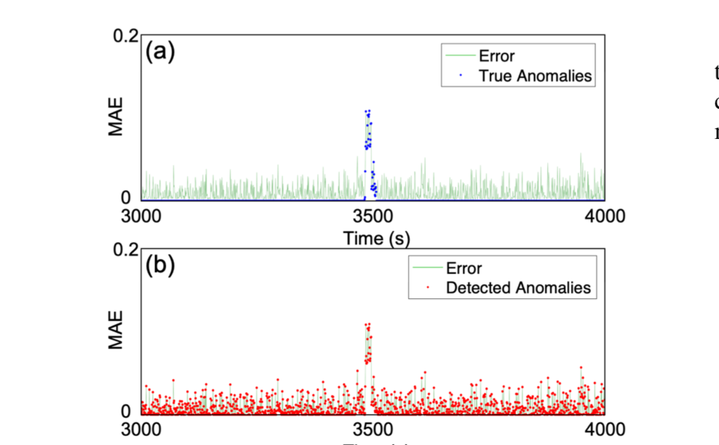
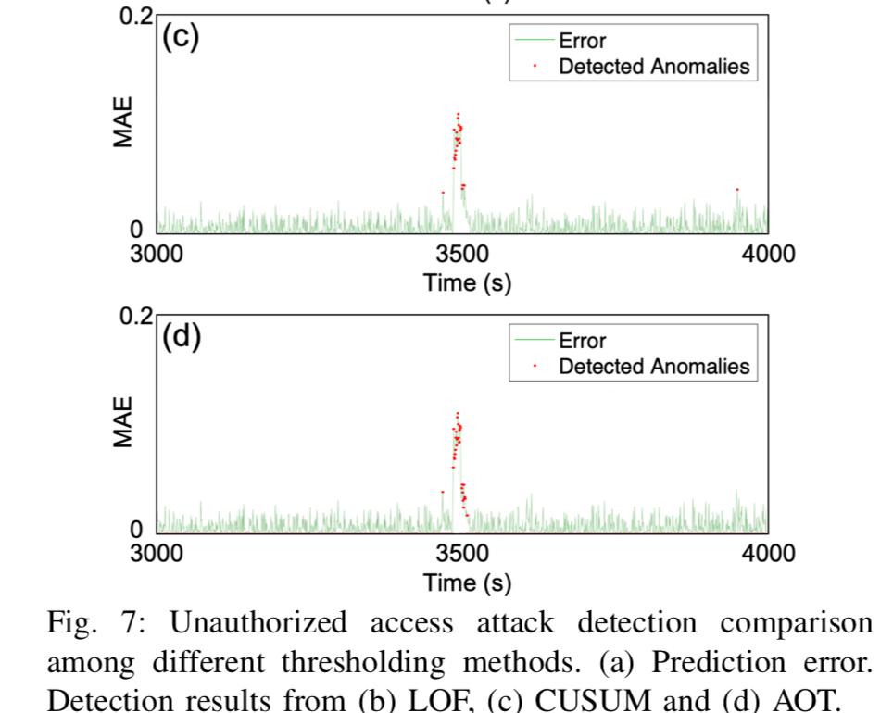
Results and Evaluation : Anomaly Detection Case Study
Notes:
Unauthorized access: lack authentication, sensitive data manipulation;

Slide 32
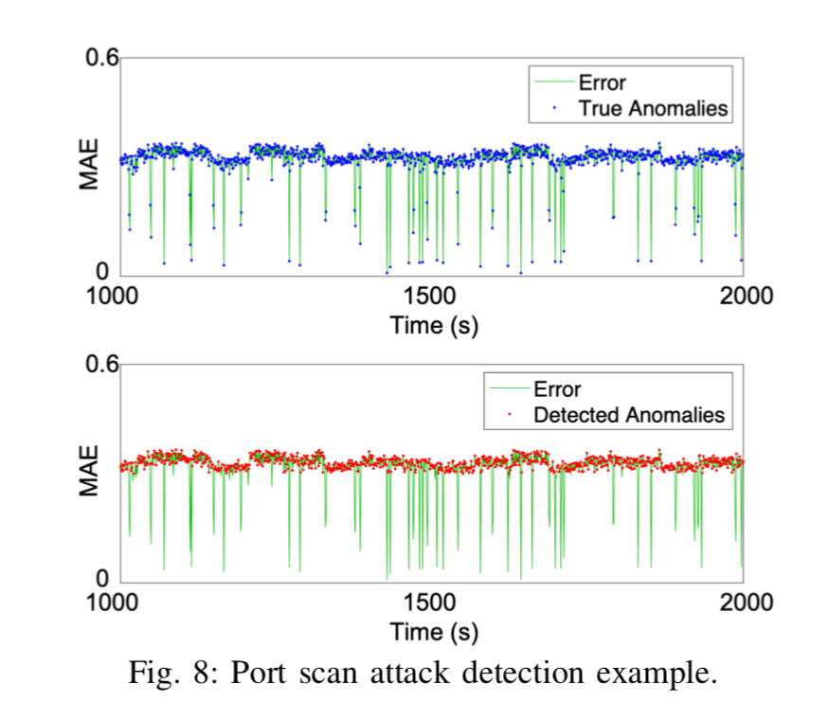
Results and Evaluation : Anomaly Detection Case Study
Notes:
Port scan: send a message to each port to test if the port has some weekness;

Slide 33
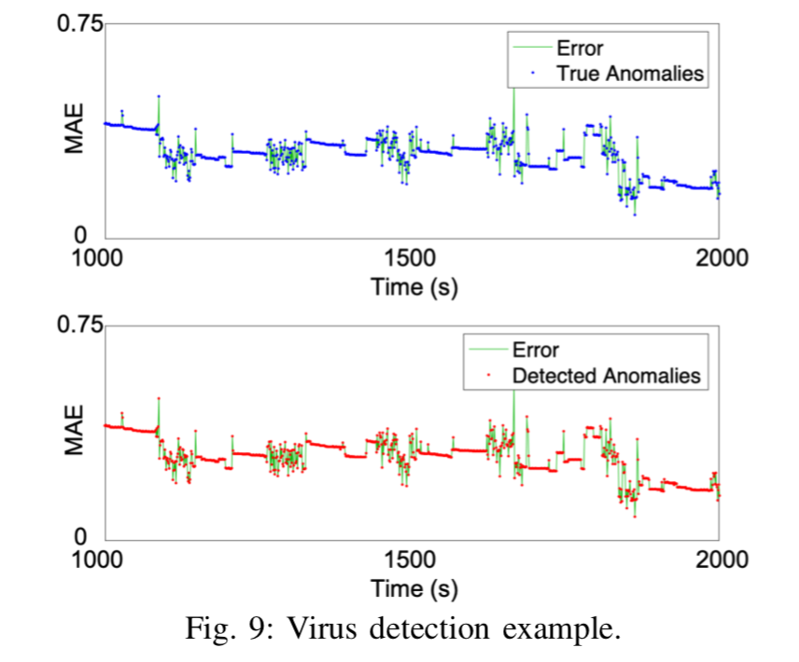
Results and Evaluation : Anomaly Detection Case Study
Notes:
Virus: run extra process.

Slide 34
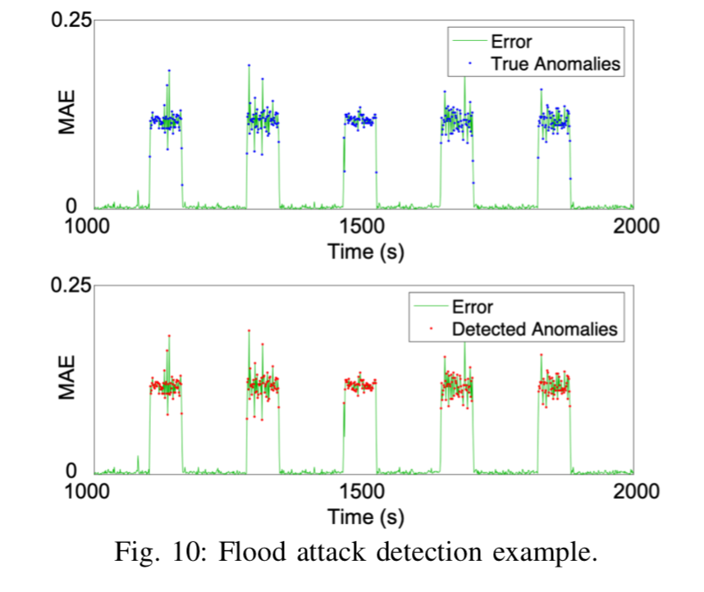
Results and Evaluation : Anomaly Detection Case Study
Notes:
Flood: DoS, make the device unreachable.

Slide 35
Conclusions
This paper has proposed a general anomaly detection based framework for detecting cyber attacks and malicious behavior in IoT devices with limited computation and communication resources.
Can be implemented on any device (from small sensors to laptop scale computation nodes)
Especially suitable for auto-sustainable IoT devices
They have shown statistical techniques and machine learning models are effective to detect attacks on IoT devices
Possible to learn the behavior models of IoT devices using simple machine learning models
Notes:
Cyber attacks on auto-sustainable IoT devices leave behavior traces in system statistics.

Slide 36
MLoNs Final Presentation
Part IV: Discussion and Future Work

Slide 37
Open issues in anomaly detection algorithms
Adaptability
Adaptive to the changing properties of network attacks
Adaptive to changing environment.
Adversarial Machine Learning
Optimization algorithms
Benchmark Network Intrusion Dataset
To evaluate different algorithms
Requirement: unbiased, realistic and comprehensive
Fast Feature Selection Method
Effectively pick up the most important features of attacks
Reducing Computational Complexity
preprocessing, training and deployment
Notes:
*Adaptability: The nature of anomalies keeps changing over time as intruders adapt their network attacks to evade existing intrusion detection solutions. So, adaptability of the detection method is necessary to update with the current anomalies encountered in the local network or the Internet.
*Adversarial Machine Learning: It’s helpful to recall a common metaphor: security is sometimes thought of as a chess game between two plays.
*Scalable machine learning algorithms are a class of algorithms which can deal with any amount of data, without consuming tremendous amounts of resources like memory.
*Only a few intrusion datasets with sufficient amount of attack information are available publicly.
*Developing an appropriate and fast feature selection method for each attack class.

Slide 38
& My Research Problem – LifeSec Project
Physical Layer Security Protection
RSSI
LQI
ETX
FFT features
Notes:
Sensor: use physical layer features to detect the transmission pattern.
Sensor network is distributed, then distributed algorithm maybe will play a role
Also, now many IDS designs only concern about the model to choose and less concern about the algorithm to achieve the optimization

Slide 39
References
Hodge, Victoria, and Jim Austin. “A survey of outlier detection methodologies." Artificial intelligence review 22.2 (2004): 85-126.
Bhuyan, Monowar H., Dhruba Kumar Bhattacharyya, and Jugal K. Kalita. "Network anomaly detection: methods, systems and tools." Ieee communications surveys & tutorials 16.1 (2014): 303-336.
Gogoi P, Bhattacharyya D K, Borah B, et al. A survey of outlier detection methods in network anomaly identification[J]. The Computer Journal, 2011, 54(4): 570-588.
Li, F., Shinde, A., Shi, Y., Member, S., Ye, J., & Member, S. (2019). System Statistics Learning-Based IoT Security : Feasibility and Suitability. IEEE Internet of Things Journal, X(X), 1–8. https://doi.org/10.1109/JIOT.2019.2897063
Huang, L., Joseph, A. D., Nelson, B., & Rubinstein, B. I. P. (2011). Adversarial Machine Learning, 43–57.
Ahmed, Naser Mahmood, and Hu. "A Survey of Network Anomaly Detection Techniques." Journal of Network and Computer Applications 60.C (2016): 19-31

Slide 40
Thank you! 🙂 Questions?
Notes:
Cyber attacks on auto-sustainable IoT devices leave behavior traces in system statistics.

